Slide 1


Group B
Home
Photo
About Us
Contact
SALES DATA
ANALYSIS & INTERPRETATION

Slide 2

Group B
Home
Photo
About Us
Contact
Group B
Adhish Rajendran Pillai
Ashwin Muthusamy
Ganga Hariharan
Omkar Krishnapurkar
Yashwanth Duddupuddi
About Project
Our analysis aims to enhance data quality in a comprehensive sales dataset containing 9,998 entries from a US-based business. This dataset includes critical factors like order and shipping dates, client segments, geographic locations, and sales figures. Firstly we’ve addressed the missing values and discrepancies to ensure data accuracy and reliability.
Next, we've created visualizations highlighting sales trends over time, profitability by client categories, and performance by geographic region. These insights will empower the business to optimize sales strategies and drive better overall performance, aligning with their strategic objectives.

Slide 3
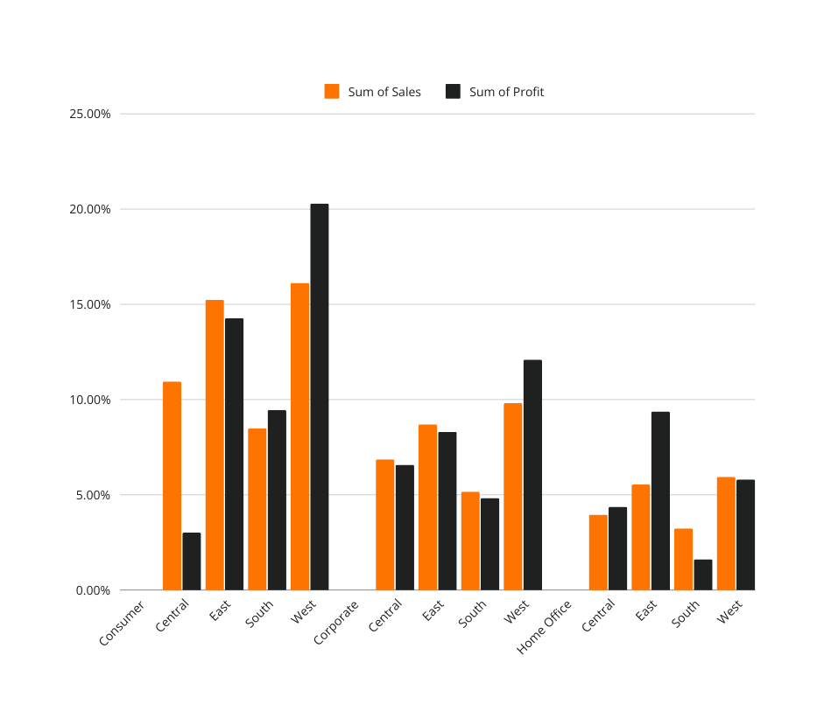
Group B
Home
Photo
About Us
Contact
Sales and Profit based on region.
  Sales vs. Profit Comparison:
    The chart shows both the sum of sales (orange) and sum of profit (black) across different regions and customer segments, providing a direct comparison.
  Top-Performing Segments:
    Corporate Segment: Strong performance in both sales and profit, especially notable in the West region.
    West Region: Shows the highest overall profit across segments, particularly for Corporate customers.
  Regional Trends:
    East and South Regions: Display lower profit margins across customer segments despite moderate sales.
    Central Region: Consistently shows lower profit compared to other regions, with sales also being comparatively lower.
  Consumer Segment Performance:
    In most regions, the Consumer segment has relatively high sales but lower profits, suggesting potential areas for margin improvement.
  Home Office Segment:
    Limited sales volume and profits, with the West showing the best performance for this segment.

Slide 4
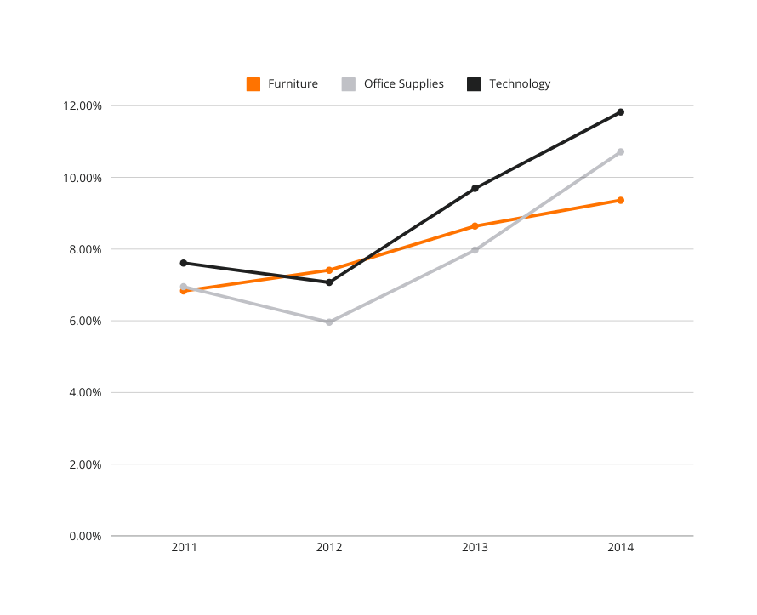
Group B
Home
Photo
About Us
Contact
Sales calculated on yearly basis.
01
Rapid Growth in Technology: The Technology category shows the most significant growth, climbing from approximately 8% in 2011 to nearly 12% by 2014, indicating strong market demand and expansion potential.
02
Consistent Upward Trend Across All Categories: All product categories show an upward sales trend from 2012 onward, reflecting overall positive growth in sales performance.
03
Office Supplies Recovery: Office Supplies experienced a dip in 2012 but rebounded strongly, reaching over 9% in 2014, suggesting effective strategic adjustments or market recovery in this category.
04
Moderate Growth in Furniture: Furniture shows the slowest growth among the three categories, increasing steadily but more modestly, highlighting a potential need for targeted strategies to accelerate growth.
Investment Opportunity in Technology: Given Technology’s rapid and sustained growth, further investment and focus on this category could capitalize on its upward trajectory and drive higher overall sales.
05

Slide 5
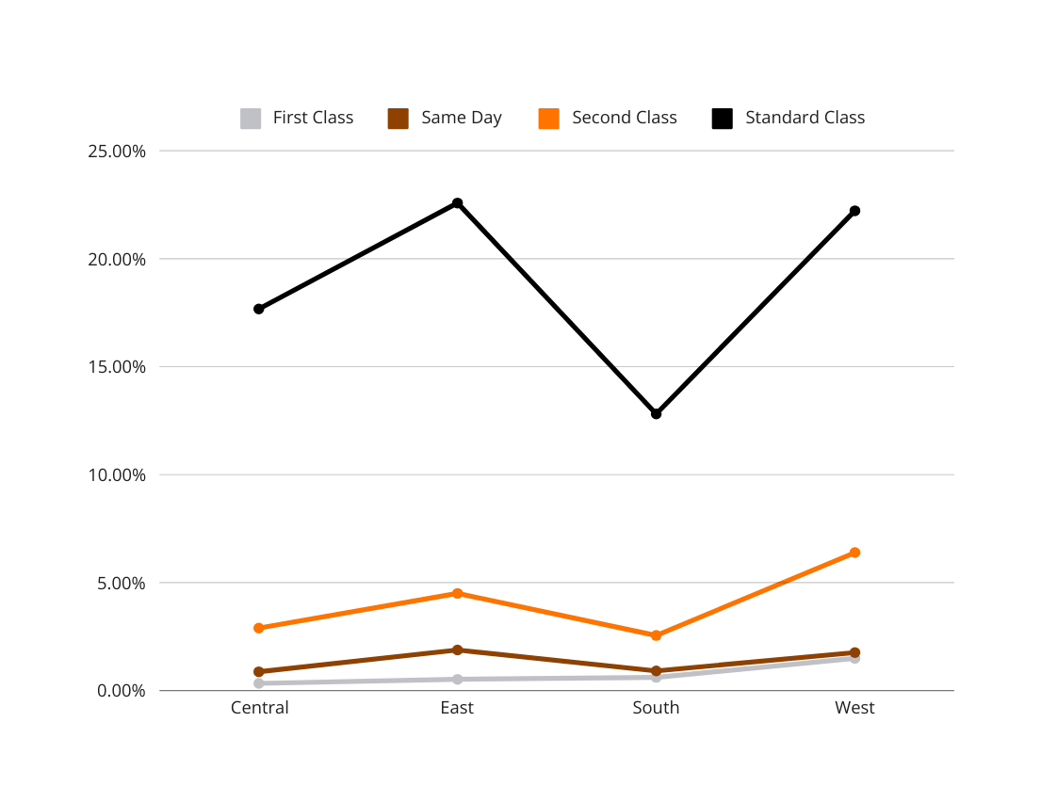
Group B
Home
Photo
About Us
Contact
Region Specific Shipping mode.
Dominance of Standard Class:
  Standard Class shipping is the most widely used mode across all regions, especially in the West, where it reaches over 30%, indicating a strong preference for cost-effective shipping options.
Regional Variation in Standard Class Usage:
  The East and South regions have lower usage of Standard Class compared to the West, suggesting a potential opportunity to promote this option more effectively in these areas.
Low Adoption of Same-Day and First Class Shipping:
  Both Same Day and First Class shipping have minimal usage across all regions, indicating that customers might prioritize economy over speed, or there may be limited availability of faster options.
Second Class as a Consistent Option:
  Second Class shipping maintains a consistent, moderate presence across all regions, serving as a reliable middle-ground option for customers who need a balance between cost and speed.

Slide 6
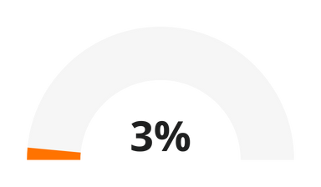
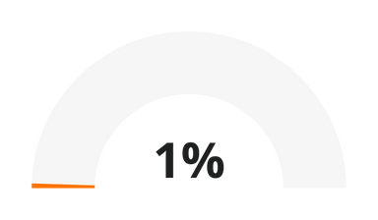
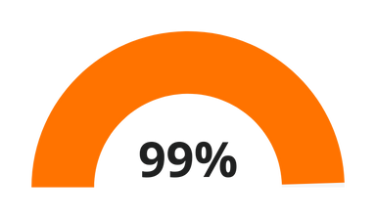
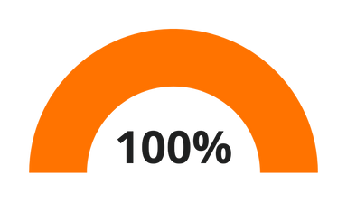
Group B
Home
Photo
About Us
Contact
SUMMARY
DUPLICATES
ERROR
RECOVERED/ FIXED
DATA SANITIZED
  Data Cleansing: We’ve successfully identified and addressed 3% duplicate entries and 1% errors in the sales data, ensuring a cleaner dataset.
  Data Recovery and Sanitization: With 99% of data issues recovered/fixed and 100% of the data sanitized, we've ensured high data quality and integrity, making it reliable for accurate analysis and reporting. This reflects a thorough and effective data validation and cleansing process on the basis of our understanding.

Slide 7

Group B
Home
Photo
About Us
Contact
THANK YOU

